Slide 1


Ethical Theories
Lecture 2

Slide 2
By the end of this session you should be able to:
describe ethical theories we discussed in the class
compare and evaluate different ethical theories we discussed
differentiate between ethical relativism & ethical absolutism
Key terms: Consequentialist ethics, deontological ethics, virtue ethics, egoism,
utilitarianism, Kantian ethics, categorical imperative, ethical absolutism, ethical relativism

Slide 3
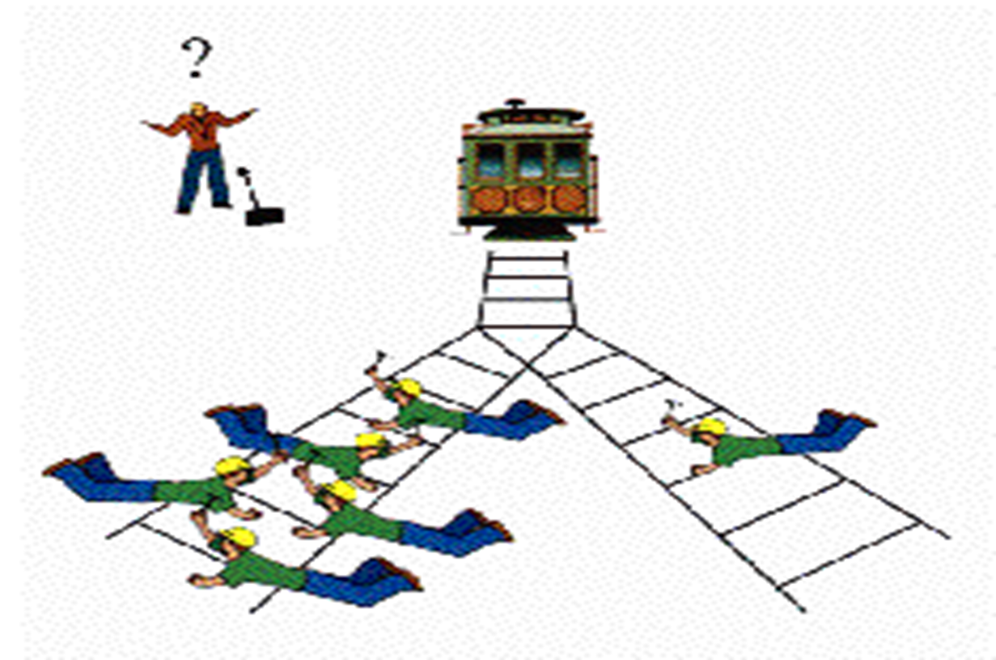
The Trolley Problem
What's the right thing to do?
What would you do?
Why? What is principle behind the moral reasoning?
https://www.youtube.com/watch?v=bOpf6KcWYyw

Slide 4
The Trolley Problem( Large Man Version)
what's the right thing to do?
What would you do?
Why?
https://www.youtube.com/watch?v=yg16u_bzjPE

Slide 5
The Trolley Problem( Large Man Version)
What is the difference between two cases?
Are you adhering to the same moral principle in both cases while making ethical judgement?

Slide 6
Moral Principles
Consequentialist: Consequences or outcomes decide the moral worth of an action
Deontological: morality is set of categorical duties which need to be fulfilled regardless of the consequences

Slide 7
Consequentialism
An ethical theory that judges whether or not an action is right by what its consequences are
https://ethicsunwrapped.utexas.edu/glossary/consequentialism
It is an example of Ethical Relativism which holds that moral principles and moral values vary/ are changeable

Slide 8
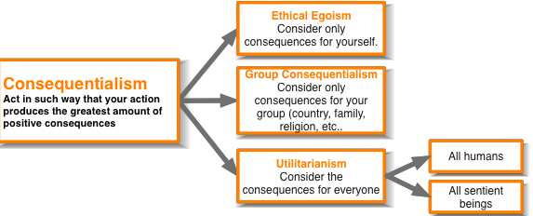
Consequentialism

Slide 9
Deontological Ethics
Deontological ethics holds that at least some acts are morally obligatory regardless of their consequences.
https://ethicsunwrapped.utexas.edu/glossary/deontology
It is form of Moral Absolutism, a theory which holds that there are certain universal and unchangeable moral principles by which all peoples’ actions may be judged.

Slide 10
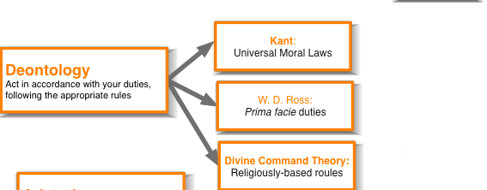
Deontological Ethics

Slide 11
Kantian Ethics
Critical Importance of Good Will:
Good will is an intrinsic good (good in itself)
Good will: the desire to do the right thing
Good will= dutifulness (sense of duty)
Reason should cultivate desire to do right thing

Slide 12
Imperatives (Duties)
Hypothetical Imperatives Categorical Imperatives
Conditional Obligations Unconditional/ Absolute Obligations

Slide 13
Categorical Imperative (1st Formulation):
“Act only from moral rules that you can at the same time will to be universal moral laws.”

Slide 14
Categorical Imperative (2nd Formulation):
“Act so that you treat both yourself and other people as ends in themselves and never only as a means to an end”

Slide 15
Virtue Ethics
What kind of person I should be?
Living a good life by cultivating an excellent (virtuous) character….
No focus on particular principles or their consequences
What are the traits of character that make a person a morally good human being?
https://ethics.org.au/ethics-explainer-virtue-ethics/

Slide 16
According to Aristotle:
"Moral virtue is ... a mean between two vices, one of excess and the other of deficiency, and ... it aims at hitting the mean in emotions and actions."

Slide 17
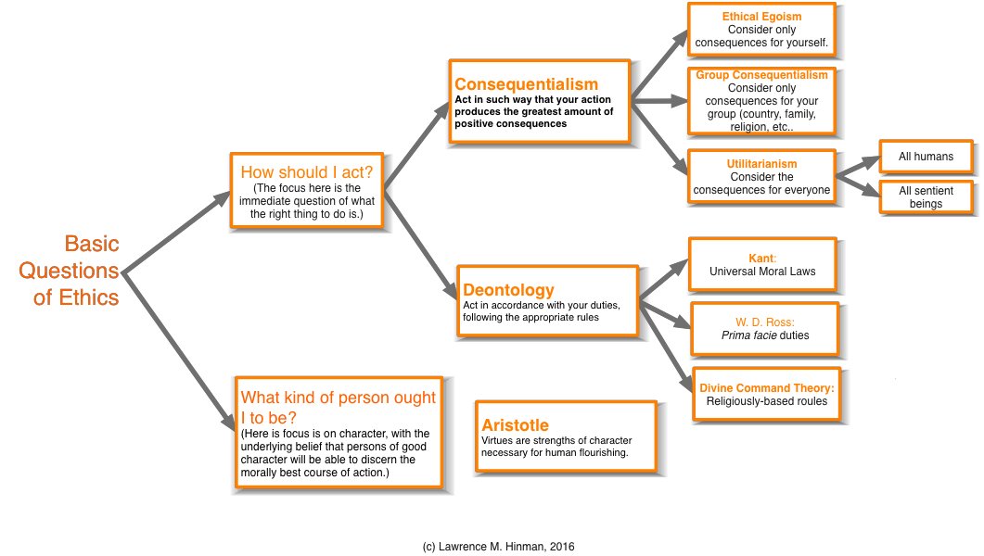

Slide 18
“Know thyself” Self-Assessment
https://www.youtube.com/watch?v=zccoaL0stbM

Slide 19
Thank You

